Slide 1
Demorad Data Acquisition

Slide 2
DemoRad Block Diagram
DemoRad
DSP-
BF706
Control, Data Acquisition
PC
Target Identification & Visualization
Rx
5904
AFE
7251
Quad SPI
4 RX Antennas
Python Script
Tx
5901
PLL
4159
SPI
USB
USB
2 TX Antennas

Slide 3
FMCW Default Specifications
1
2
129
1
2
180 MHz
40 msec
283usec
36.50 msec
1 Data Cube = 128 ramps
Range FFT – 256, Doppler FFT – 128
In one frame interval (40 msec), there would be
1st Ramp is Ignored
256*128(32K) Valid Samples + 27*128 (3K) Invalid Samples per Channel
For 4 Channels, 128K Valid Samples + 12K Invalid Samples ( 1 Sample = 2 Bytes)
For 4 Channels, 256KB of Data + 24KB of Invalid Sample data
Note : During AFE data transfer to processor we drop the invalid samples for 127 ramps through DMA. Hence L2 memory required on processor is 256KB + 27*4 (Bytes)

Slide 4
Data Acquisition Sequence Diagram @ 1 MHz Sample Rate
283 us
256*4 samples
256*4 samples
1
2
3
Ramp
Ramp Complete
Conv_start
FS (Inverted SPI SEL)
SPI_CLK (16 MHz)
CH1
CH2
CH3
CH4
CH1
CH2
CH3
CH4
CH1
CH2
CH3
CH4
CH1
CH2
CH3
CH4
(20)*4 samples
256*4 samples
(27)*4 samples
SPI_DATA
4

Slide 5
ADC and Sample Rate Notes
Sample rates of 1 MHz, 1.2 MHz, or 1.8 MHz are possible with DemoRad
Make sure that the ramp period divided by the sample period is an integer in order to maintain coherent data
We have example settings that show this
Quad-SPI is used to transfer data from the ADC to the processor in nibble-wide mode because byte-wide mode requires PPI which allows only 1 CAN on BF70x instead of two (due to pin mulitplexing)

Slide 6
Data Buffer Handling on the processor – Ping Pong
L2 SRAM
While the AFE is writing to one buffer, processing is done on the other buffer. After one buffer is full, the pointers are swapped (input pointer=pong, output buffer = ping).
SPI starts DMA of data into an L2 buffer pointed by input pointer
A portion of the buffer pointed by the output pointer is transferred into L1 via MDMA
The FFT algorithm is run on the data in L1 with the results being stored back in L1
The FFT results are written back into the buffer pointed by the output pointer using MDMA
USB sends the whole buffer (256KB) pointed by the output pointer
Input and Output pointers are swapped
Goto 1
input pointer
AFE
7251
Driver
256KB
Buffer
ping
SPI DMA
1
MDMA
3
output pointer
256KB
Buffer
pong
L1 SRAM
2
FFT
MDMA
4
Skipped on DemoRad, raw samples provided to PC
5
USB
STACK

Slide 7
Introduction to Radar Algorithms

Slide 8


FMCW Radar concepts
1
2
..N
1
2
∆B
M
M
M
M
M
R_{Time}
T_{ON}
T_{OFF}
T_{F}
Range Resolution $∆R=\frac{c}{2∗∆B}$
Velocity Resolution $∆V= \frac{λ}{2∗N∗Rtime}$
Angle Resolution$Δθ= \frac{λ}{D}$
M - FFT points for Range Determination
N - FFT points for Velocity Determination
T_{on} (Dwell time) - Time of Transmit Antenna is working
T_{OFF} – Time of Transmit Antenna is Not Transmitting
R _{time} – Total (up + down) time for each Ramp
D – Width of Antenna Receive Array
$λ$ – Transmitted Wavelength
Notes:
Range resolution depends on carrier sweep bandwidth, a hardware-dependent parameter. A higher sweep bandwidth could lead to a better range resolution.
Velocity resolution depends on dwell time and carrier frequency. The dwell time means how much time a Radar could spend on targets. The higher the carrier frequency or the longer the dwell time, the higher the velocity resolution.
Angular resolution depends on carrier frequency and radar effective area. D = (N-1)*$λ$/2. N is the number of Antenna. If we only use one Tx, N = 4 , it is our embedded version.

Slide 9
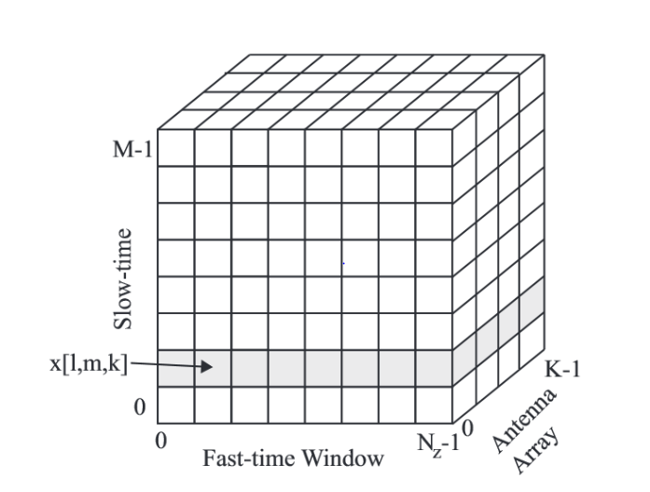
FMCW signal chain in the demo
Multichannel baseband data
(4 or 7 channels for Demorad)
2*1D-FFT
Beamforming
CFAR
based
Detection
2D- FFT : Transformation to frequency domain for range/velocity estimation
Windowing to shape the signal and reduce spectral leakage
Performed as 1D FFT on the rows followed by a 1D FFT on the columns
Beamforming: Estimation of angular position
Calculate the magnitude and phase based on the antenna array
Complex dot product for all the channels in each direction of the beam
CFAR: Detection of target against clutter (noise)
Separate the signal from the background clutter
Notes:
4 channels for only one Tx is used
7 channels for MIMO

Slide 10
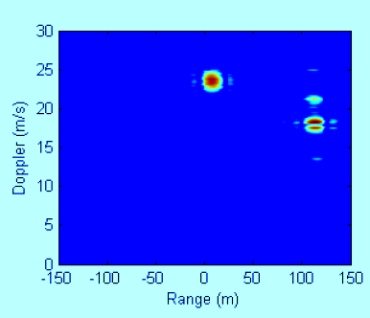
Range and Doppler Frequencies using 2D Fourier Transform
f
fs
…..
1
2
3
N
t
ts
Doppler
N
…..
Signal Amplitude
3
2D-FFT
2
1
range
Notes:
FFT is 1 dimension and has been optimized for BF70x processors with a integrated window function. Users only need to provide twiddle coefficients and window coefficients.

Slide 11
FFT
Perform Windowing on input data using Kaiser window
Range FFT – 256 point FFT performed on each ramp data
Doppler FFT – 128 point FFT performed vertically
16-bit fixed point FFT optimized for Radar data
Range FFT
Ramp 1
Ramp 2
Doppler FFT
Ramp 128
Perform Range FFT of all 128 ramps of all 4 channels. Since it’s a 16-bit FFT and data has only real part can perform FFT of 2 channels together.
Truncate upper half of FFT output (reducing to 128 columns)
Perform Doppler FFT of all 128 columns of all 4 channels
Notes:
For each ramp, we sample 256 points and perform 256 point FFT that has a window running first.
Because negative frequency is symmetric, we drop off 128 points after range FFT, and therefore have 128 point complex numbers left.
Then we do velocity 128 point FFT.

Slide 12
Firmware Block Diagram ( L2 – L1 , 2D-FFT Memory Management)
.
L2 SRAM
buff_L1_fft
For 256 Point: Real to Complex FFT
Perform FFT ( Below steps happen in parallel)
256 Points in the L2 buffer pointed to by the L2_prev pointer are transferred into L1 buffer pointed by L1_FFT_in_A
256 Points in the buffer pointed by the L1_FFT_out_B pointer are transferred back in L2 in the buffer pointed by the L2_prev pointer
The 1D FFT algorithm runs on the buffer pointed by L1_FFT_in_B ptr. The result of FFT is in buffer pointed by L1_FFT_out_A ptr . Swap in and out pointers.
Repeat Step 1, 128 times ( NO_ROWS) * 4 (Channel) times
For 128 Point:Complex to Complex FFT
Perform 2nd FFT ( Below Steps happen in parallel)
128 Points in the L2 buffer pointed to by the prev pointer is transferred into L1 buffer pointed L1_FFT_in_A
128 Points in the buffer pointed by the L1_FFT_out_B pointer is transferred back in L2 in the buffer pointed by the prev pointer
The 1D FFT algorithm is run on the buffer pointed by L1_FFT _in_B output is available in L1_FFT_out_B
Repeat Step 1 ,128 times ( NO_COLS / 2)* 4 (Channel) times
`
MDMA 1
L1 SRAM
256KB
Buffer
1 KB
Buffer A
1
L1_FFT_in_A ptr
1 KB
Buffer B
L1_FFT_in_B ptr
L2_prev ptr
FFT
1 KB
Buffer C
L1_FFT_out_A ptr
MDMA2
1 KB
Buffer D
2
L1_FFT_out_B ptr

Slide 13
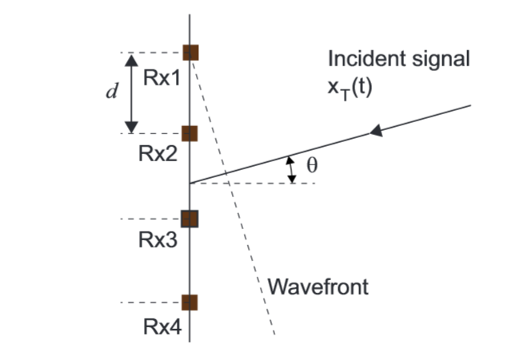
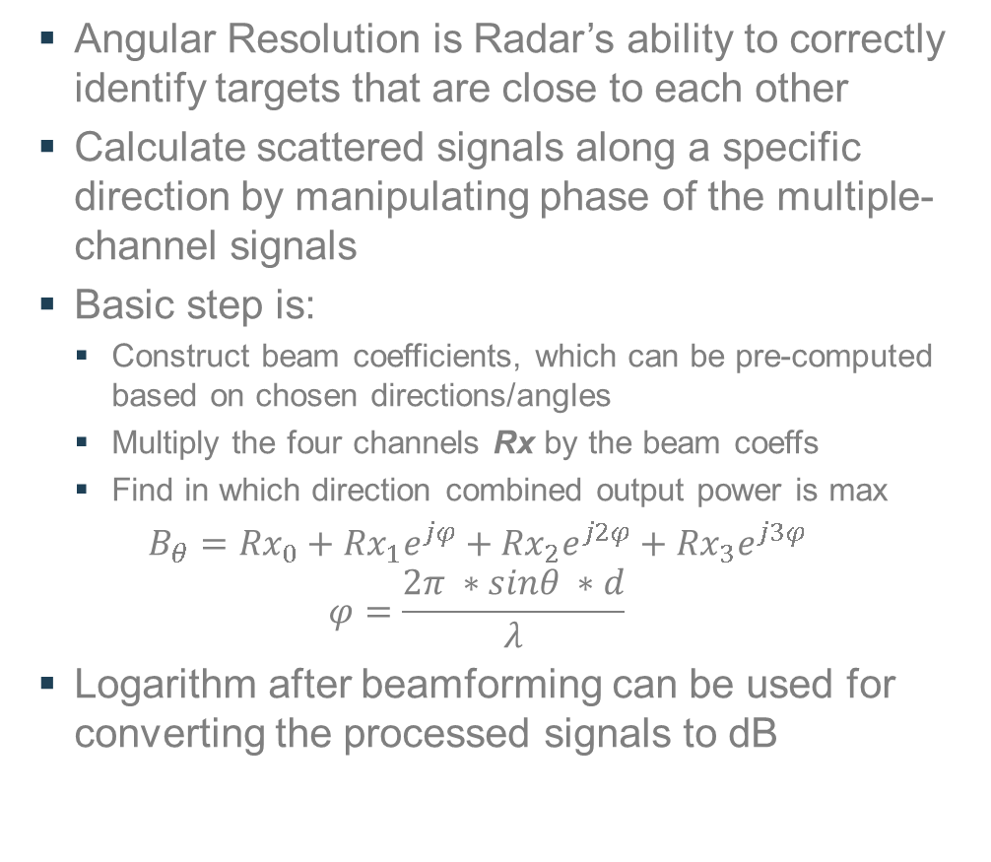
Digital Beamforming
Angular Resolution is Radar’s ability to correctly identify targets that are close to each other
Calculate scattered signals along a specific direction by manipulating phase of the multiple-channel signals
Basic step is:
Construct beam coefficients, which can be pre-computed based on chosen directions/angles
Multiply the four channels Rx by the beam coeffs
Find in which direction combined output power is max
$B_{θ}={Rx}_{0}+{Rx}_{1}e^{jφ}+{Rx}_{2}e^{j2φ}+{Rx}_{3}e^{j3φ}$
$$φ=\frac{2π ∗sinθ ∗d}{λ}$$
Logarithm after beamforming can be used for converting the processed signals to dB
Ref: Small and Short Range Radar Systems, Charvat, Gregory L.
Notes:
Beamforming math is pretty simple but consumes lots of CPU resource. We manipulate phase information of input signal from each channel as if the combined input signal comes from a particular direction.
The phase coefficients for each desired direction are pre-computed offline and loaded into system as a constant array.
Each radar board should have board-specific calibration data that would be integrated into beam coefficients.

Slide 14
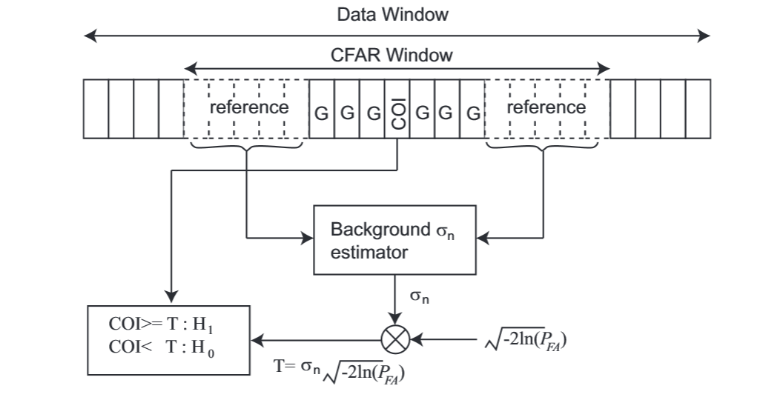
CFAR – Constant False Alarm Rate
Constant False Alarm Rate (CFAR) is a common adaptive method to detect targets against clutter by using the noise floor around the frequency of interest to decide a threshold for the detection.
There are various types of CFAR algorithm
Cell Averaging, Ordered Statistics, etc.
Basic step is :
Scans the whole data
COI (Cell of Interest) is located in the center of the CFAR window and the objective is to determine whether the COI contains a target (H₁) or not (H₀).
Several neighboring cells on either side of COI are defined as gap cells indicated by G_{s}
Averaging (CACFAR) and median filters (OSCFAR) based 1D CFAR for BF70x
Ref: Small and Short Range Radar Systems, Charvat, Gregory L.
Notes:
Pfa is probability of false alarm, usually a small number, such as 1.0e-04. This number could be determined experimentally without exactly following the above equation

Slide 15
Beamforming and CFAR Memory Management
L2 SRAM
L1 SRAM
The processed FFT data are reloaded back to L1 memory row by row for beamforming and CFAR
The L1 memory that is allocated for FFT could be reused by beamforming and CFAR but the size of L1 memory should be set as the maximum of the three modules
256KB
Buffer
MDMA 1
Buffer A
1
Buffer B
Beamforming
CFAR
Buffer C
L2 SRAM
32KB
Buffer
MDMA2
Buffer D
2
Notes:
The FFT buffer on L2 memory requires 128 (row) * 128 (col) * 4 (channels) * 4 (byte) or complex number = 256 KB
After beamforming and CFAR, the receive buffer on L2 memory requires 128 (row) * 128 (col) * 2 (byte) or 16 bit real number = 32 KB

Slide 16
Basic algorithms footprint and cycles
 | 1D FFT | Beamforming | logarithm | 1D CACFAR (Average) | 1D OSCFAR (Median)
Code in L1 (bytes) | 1883 | 84 | 122 | 184 | 276
Const Data in L1 ((bytes) | 4240 | 48 | 706 | N/A | N/A
Buffers in L1 (bytes) | 6144 | Shared | Shared | Shared | 112 + Shared
Buffers in L2 (KB) | 512 | 192 | N/A | N/A | N/A
CYCLES per sample | 82.7 | 8.3 | 7.3 | 7.7 | 104.1
 | 1D FFT | Beamforming | Logarithm | 1D CFAR
Assembly code | Yes | Yes | No | Yes
Tested with real data | Yes | No | No | No
Tested with simulated data* | Yes | Yes | Yes | Yes
Profiling settings: fract16 data, 4 RX channels, 256 range and 128 velocity FFTs, 3 beams on BF706 EZ-board
* Simulated data are the data collected from Norwood parking area
Notes:
Simulated data are the data collected from Norwood parking area

Slide 17
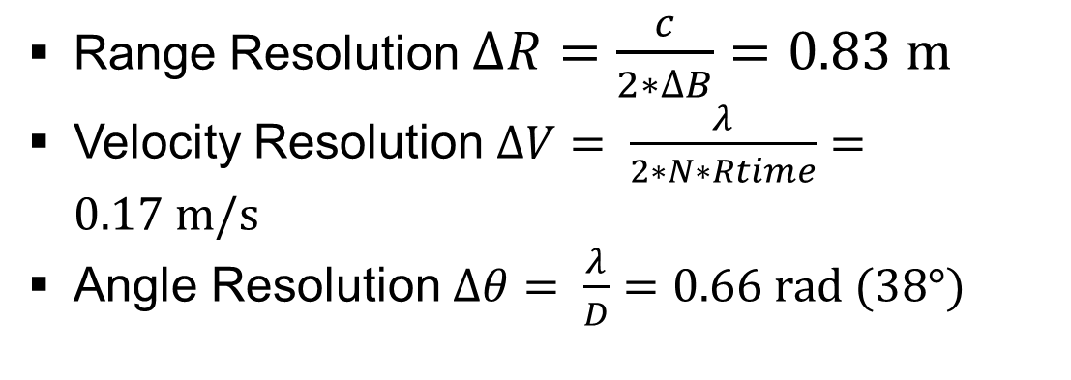
24 GHz Radar example based on DemoRad board
1
2
129
1
2
180 MHz
40 msec
283usec
36.50 msec
1 Tx channel, 4 RX channels
Range FFT – 256, Doppler FFT – 128
4 beams
OS-CFAR
Reference cells: 8 and Guard cells: 2
Total window size (include target cell): 11
25 frames per second
16 bit data
Range Resolution $∆R=\frac{c}{2∗∆B}=0.83 m$
Velocity Resolution $∆V= \frac{λ}{2∗N∗Rtime}=0.17 m/s$
Angle Resolution$Δθ= \frac{λ}{D}=0.66 rad (38°)$
Notes:
CACFAR window size doesn’t matter. MIPS are almost the same for different window sizes.
D = (N-1)*$λ$/2. N is the number of RX Antenna array. If we only use one Tx, N = 4 , it is our embedded version. We don’t use MIMO.

Slide 18
MIPS breakdown
Beamforming in 4 directions
Scanning range: [-60°, 60°], angular resolution in the processing is approximately 30°
MIPS breakdown for one frame
FFT: 1.855 M core cycles
DBF + OSCFAR: 4.354 M core cycles
Or DBF + CACFAR: 1.323 M core cycles
This Radar example should approximately consume 25 * (1.855 + 4.354) = 155.22 M cycles or 25 * (1.855 + 1.323) = 79.45 M cycles
Has MIPS left to run target detection algorithms

Slide 19
Thank You

